Slide 1
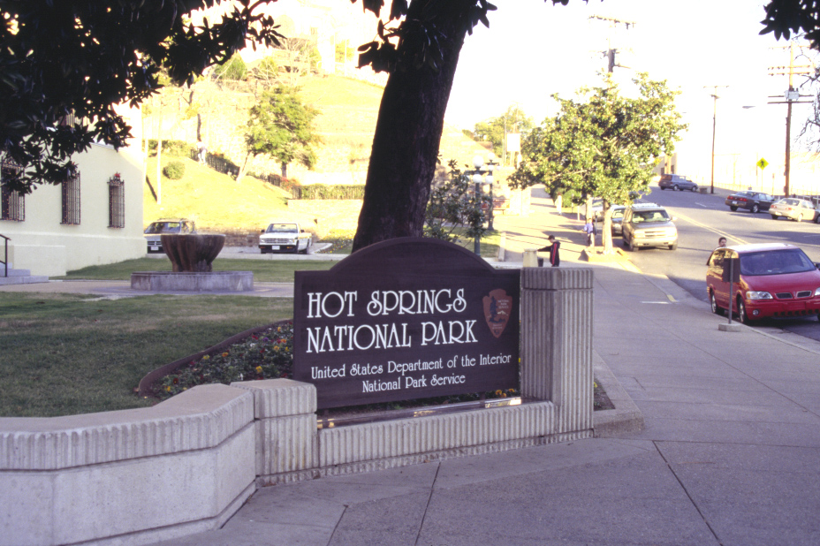
Notes:
About the only part of Hot Springs National Park that looks like a national park is the sign outside the park office. There are no entrance fees or gates here for that matter. And this really isn’t an entrance sign per say, it’s actually just to inform visitors that they have arrived, because without it, I’m sure many would just drive right by.

Slide 2
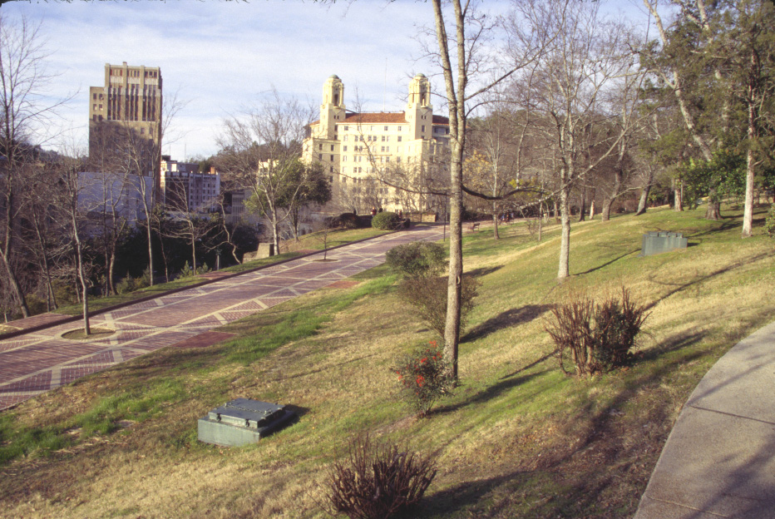
Notes:
Overlooking the curious concrete and metal plates in the grass (more on those later), one’s first impression is that this national park looks like a pretty average city park in an Anytown, USA.

Slide 3
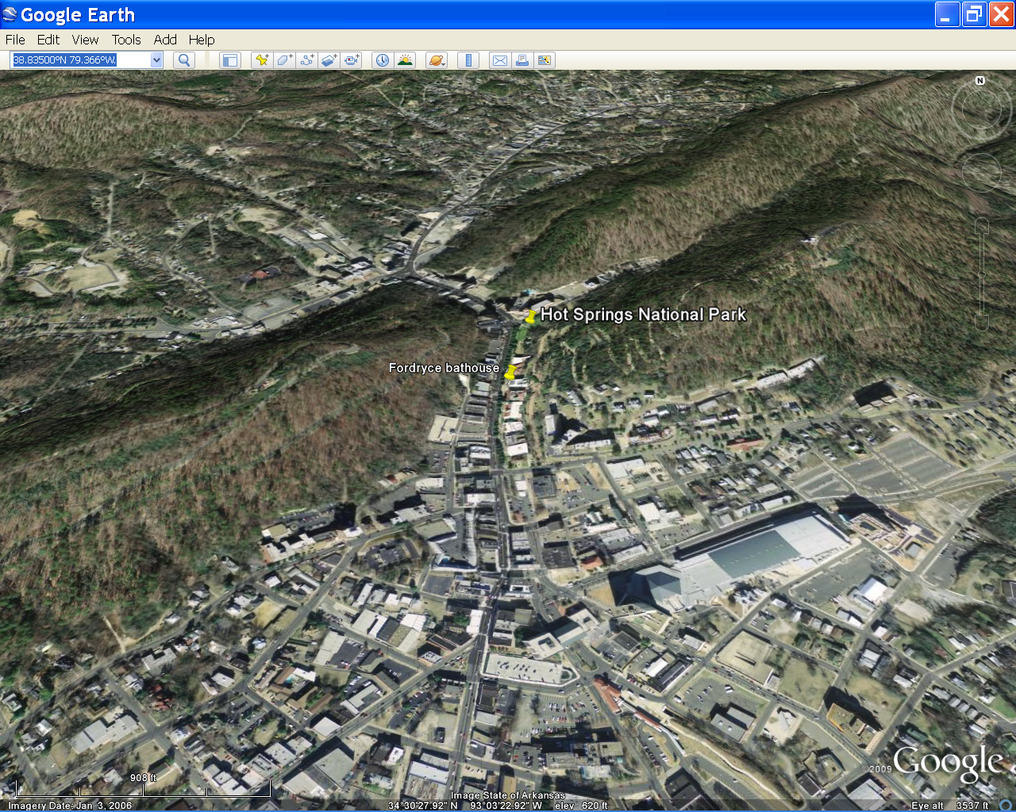
Notes:
Indeed, it’s located along Central Ave, a mere half mile from the main business district in Hot Springs, Arkansas. Don’t expect anything even remotely resembling a wilderness experience here.

Slide 4
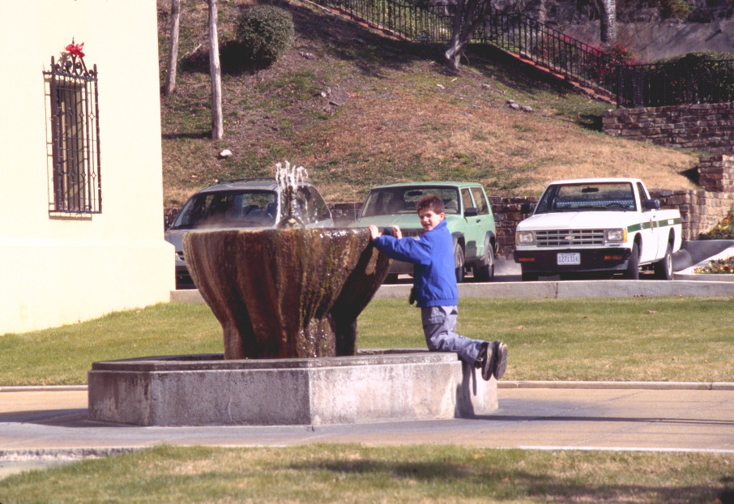
Notes:
As one blogger described it: “this is probably the least worthwhile National Park I've ever seen and could ever imagine”. I’m not sure I’d go that far, but when one of the park’s main attractions is a flaccidly spurting, warm water fountain covered with slimy mineral deposits, you’ve got to wonder if maybe someone in the Department of the Interior had their brains soft boiled after an overextended soak in one of the old bathhouses here.

Slide 5
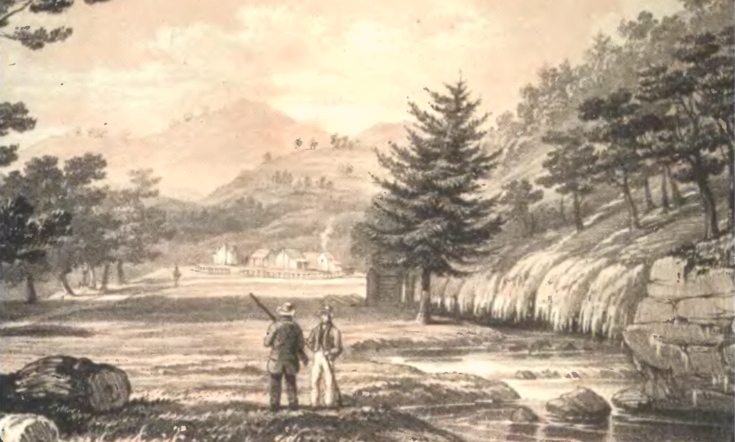
Notes:
At the time the hot springs where given federal protection back in the 1830’s, however, the existence of the enormously grander Yellowstone geothermal area had not been confirmed, so Hot Springs, Arkansas, albeit small, was a natural wonder. Steam billowed from dozens of hot springs, which brought water saturated in calcium carbonate to the surface where it precipitated to form thick deposits of gleaming white tufa. You can see the tufa here along Hot Spring Creek in this sketch from the 1840’s.

Slide 6
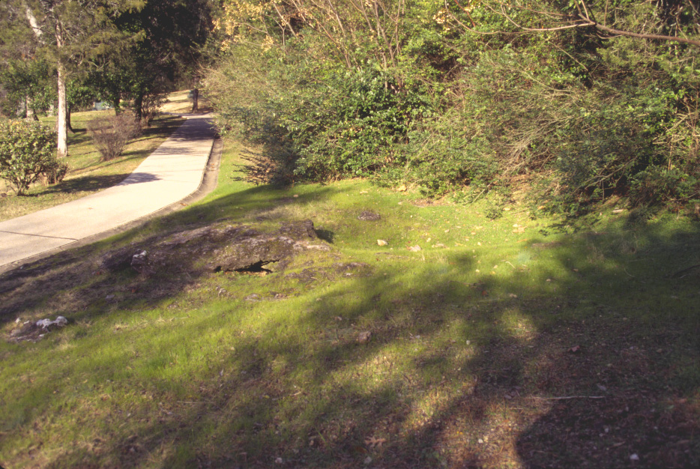
Ancient tufa
Notes:
The tufa deposits are still visible, such as in this ancient hot spring mound, …

Slide 7
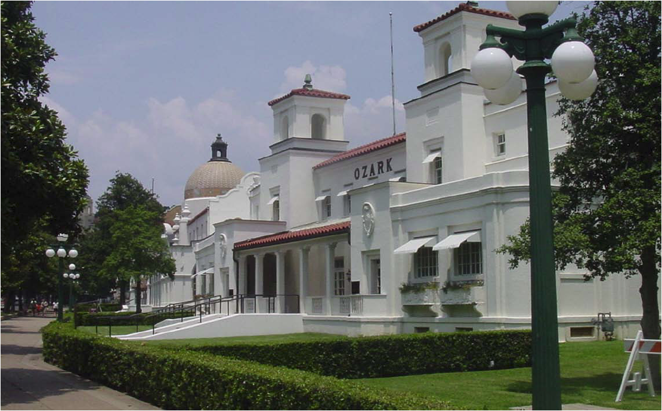
Bath House Row
Notes:
… but most of the hot water was diverted years ago to supply the bathhouses along nearby “Bath House Row”.

Slide 8
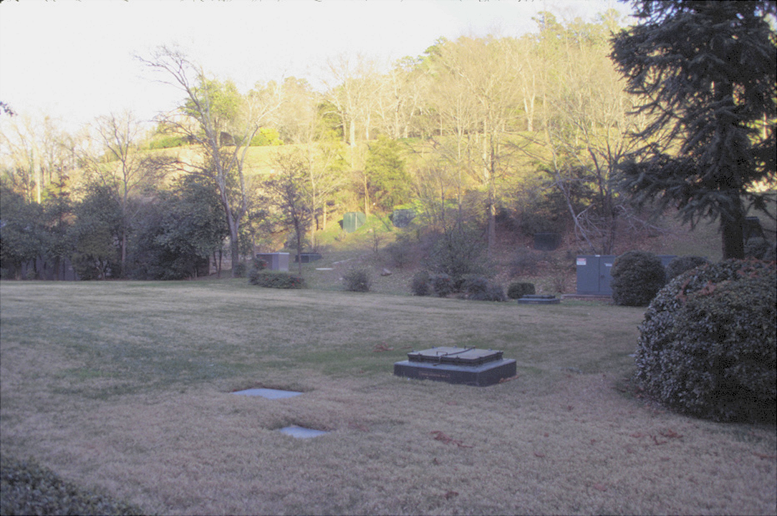
Capped springs
Notes:
Most of the former hot springs have been capped …

Slide 9
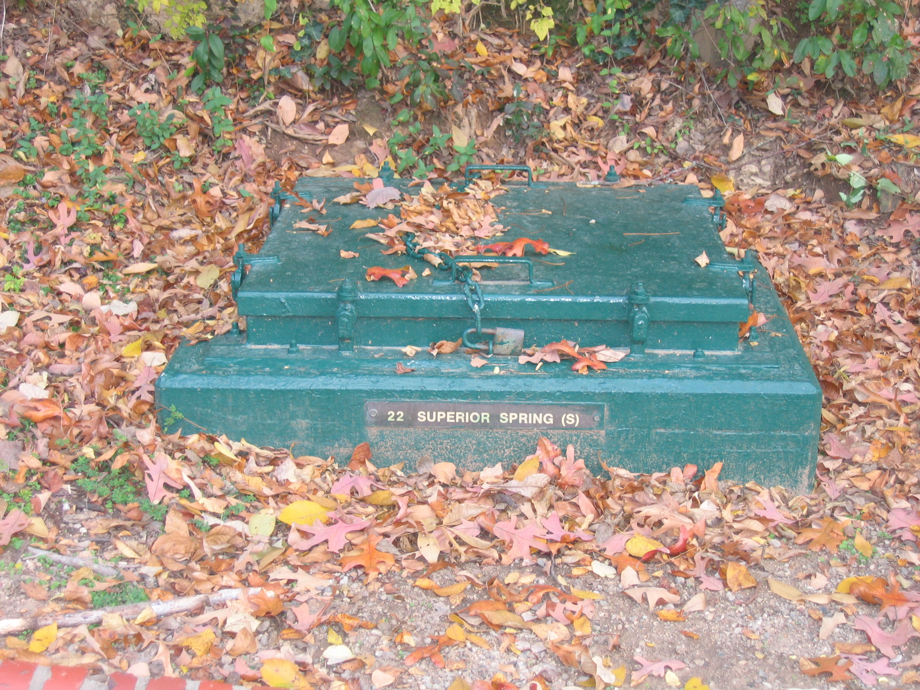
Notes:
… and locked to prevent contamination of the bath house water supply.

Slide 10
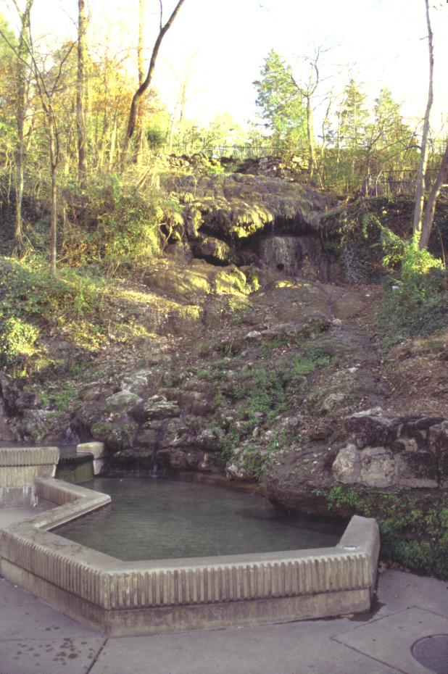
Notes:
The few uncapped hot springs that remain have drastically reduced flow compared to the pre-bath house days. As a result, very little new tufa is deposited …

Slide 11
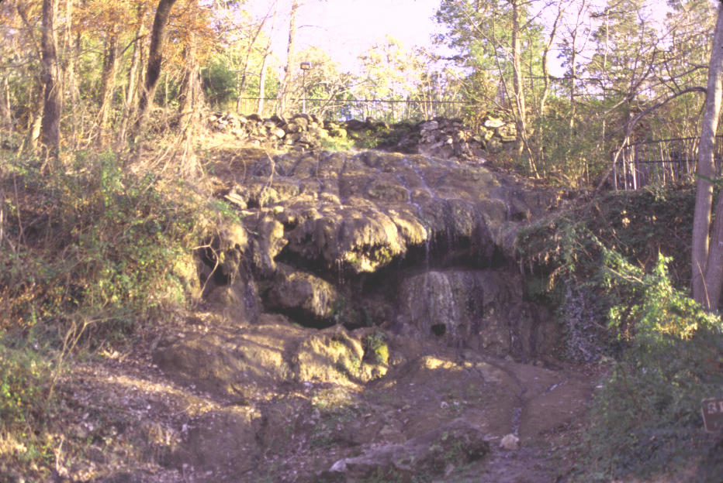
Notes:
…and soil has begun to develop on the once lustrous tufa deposits.

Slide 12
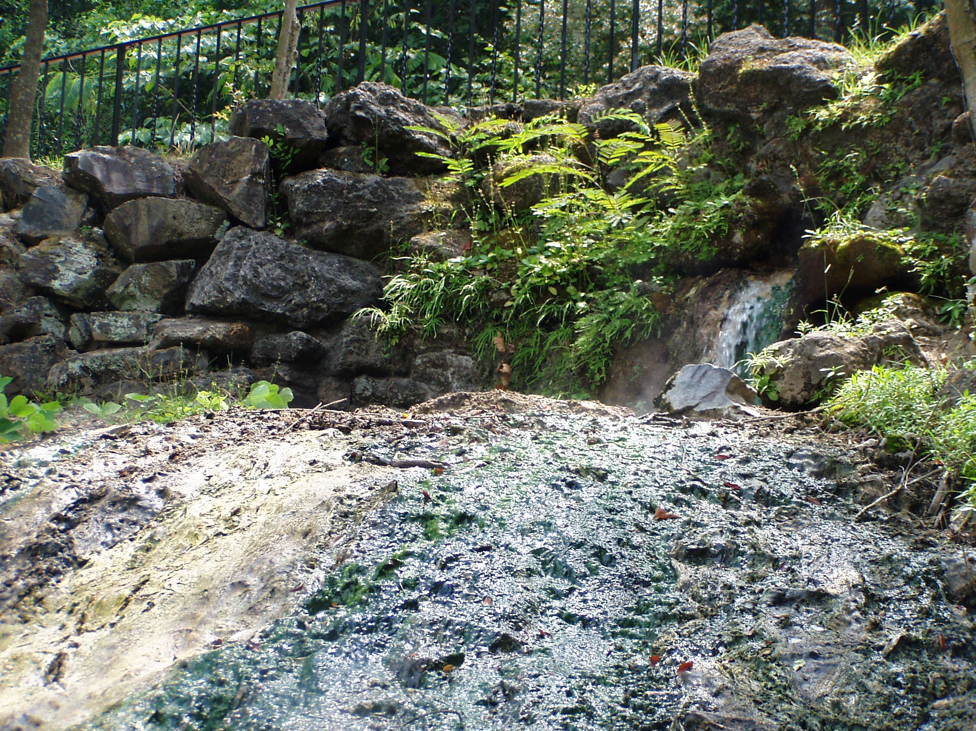
Fresh tufa
Notes:
This is one of the few remaining natural hot springs. You can see the fresh tufa deposited here.

Slide 13
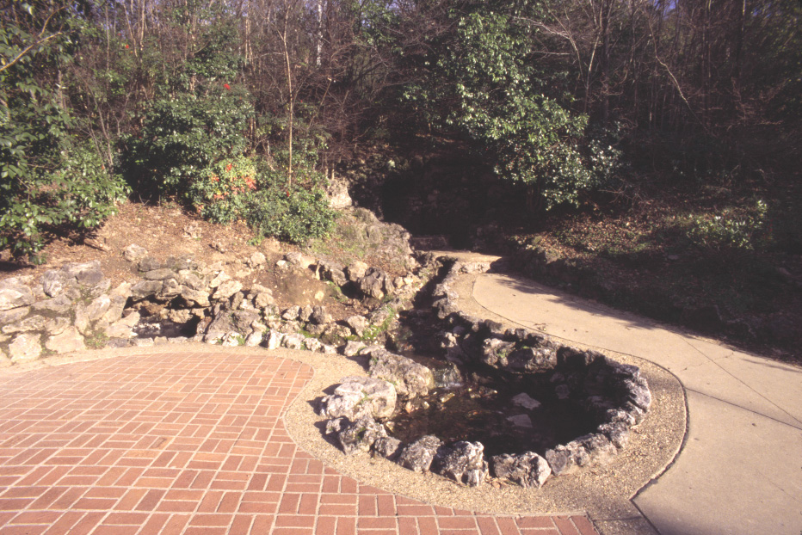
Notes:
The small amount of water that issues from the currently active springs is diverted into the decidedly unnatural looking “display springs”…

Slide 14
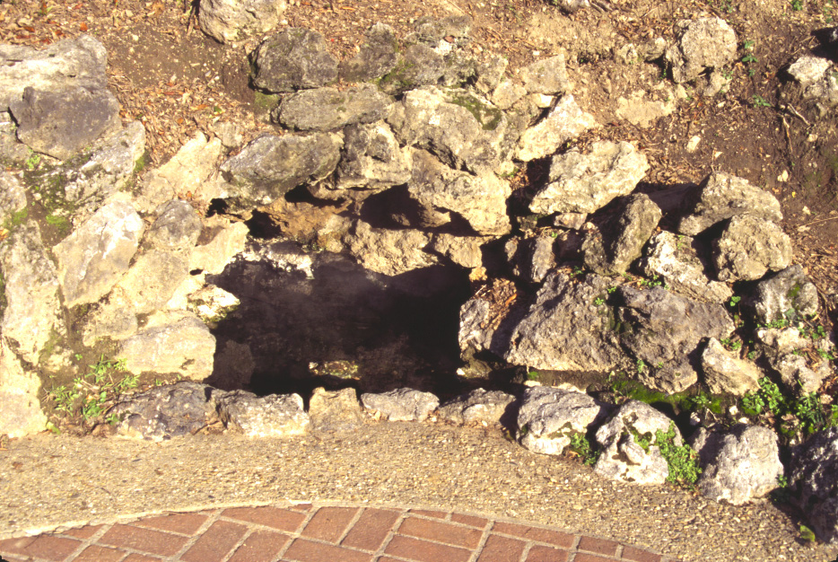
Notes:
… which are lined with cemented stones made of the tufa deposited before the bath house water diversions effectively made them extinct.

Slide 15
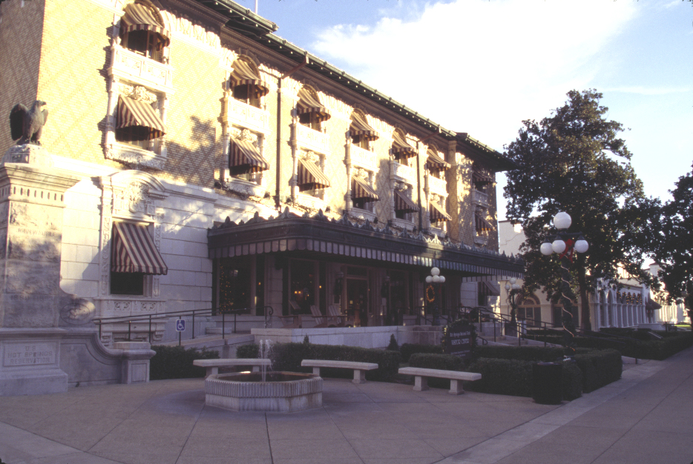
Fordyce Bathhouse
Notes:
Ironically, the bath houses are the biggest attraction at Hot Springs National Park for many visitors. This is the Fordyce Bathhouse …

Slide 16
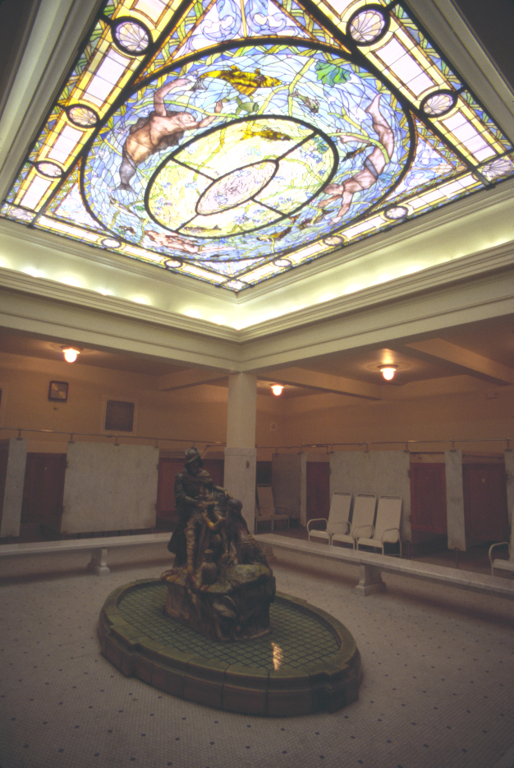
Notes:
… which has been completely restored to it’s 1920’s condition. Those where the bath house glory days, when the rich and famous flocked here ….

Slide 17
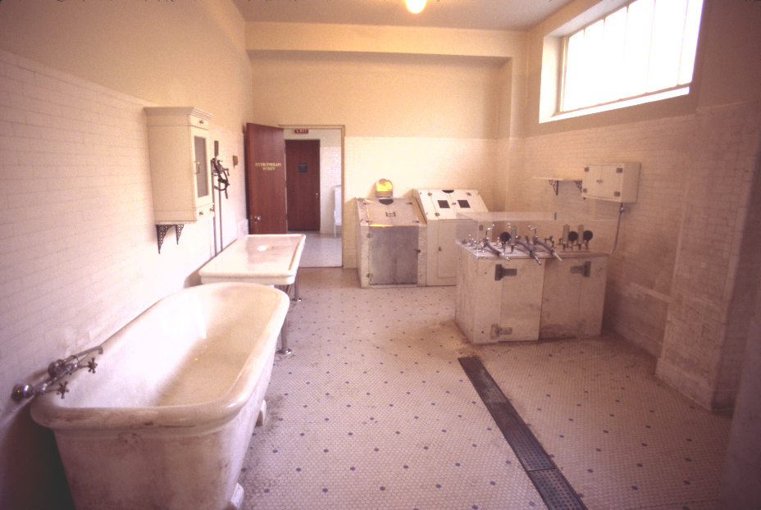
Notes:
… to partake in extended, spa-centered vacations touted to renew health and vigor. Admittedly, this is probably the last image you would have imagined seeing when you signed up for a Geology of National Parks class! It looks like a sanitarium to me, which is oddly fitting, because I think it was absolutely crazy (if not criminal) to all but destroy a natural wonder so that a few rich people could have a comfy soak and indulge the fashionable quackery of the era. Let’s get out of here!

Slide 18
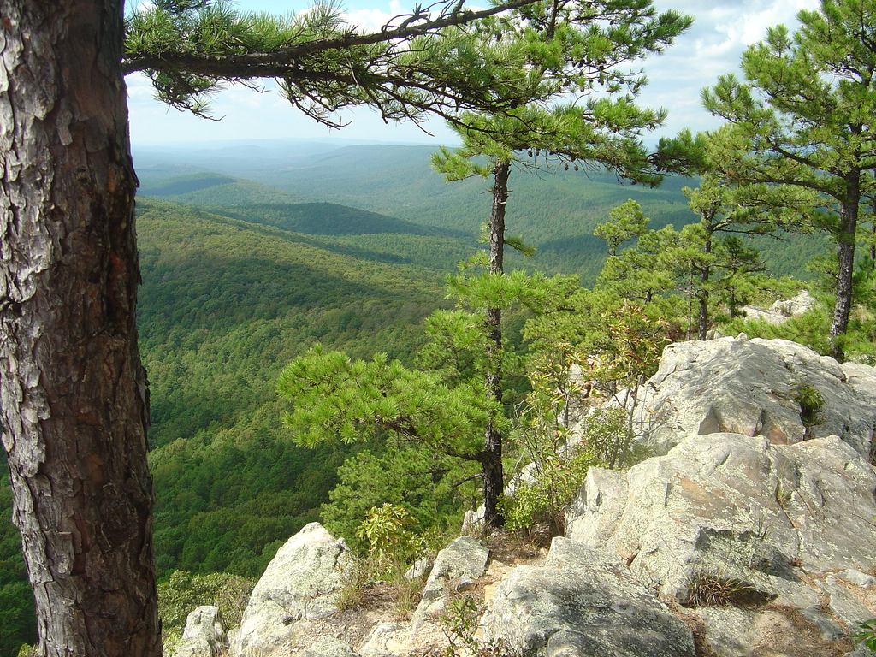
Notes:
Ah, that’s better. This is the view from “Flatside Pinnacle” in the Flatside Wilderness about 25 miles north of Hot Springs, Ar. The bright white rock resembles the Arkansas Novaculite (more on that later) and the mountains are the Ouachitas. The formation of each, as we will see, plays a key role in the origin of the hot springs.

Slide 19
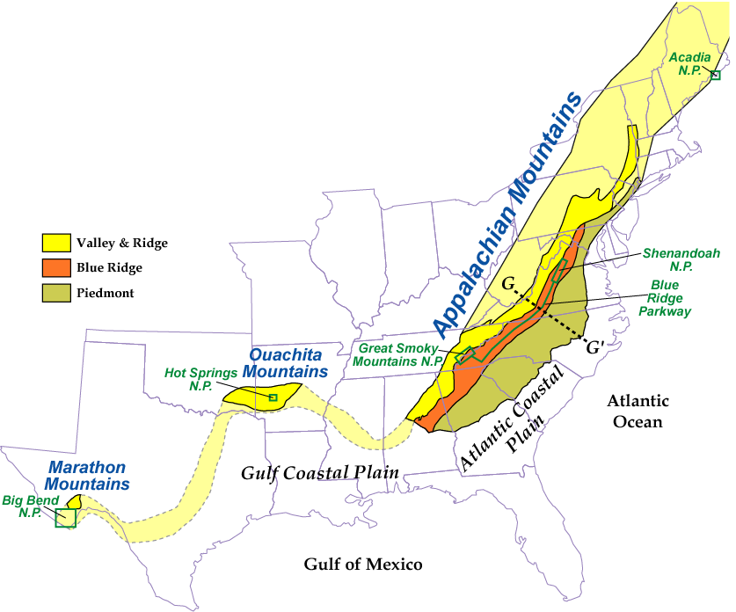
The Appalachian continental collision zones continues westward as the Ouachita Mountains in Arkansas and Oklahoma.
Parks and Plates
©2005 Robert J. Lillie
Notes:
To explain the origin of the hot springs, first let’s have a look at the regional situation. Hot Springs National Park lies near the center of the Ouachita Mountains, which like the Marathon Mountains in Texas, once formed a continuous mountain range with the Appalachians.

Slide 20
Notes:
Today, however, that connection is abruptly terminated by the Mississippi Embayment. One of the great geological mysteries of our nation centers around the creation of this embayment. How did the Mississippi cut clear through an Appalachian-sized mountain range?

Slide 21
Appalachians
Ouachitas
Notes:
On this geologic map you can see the largely Paleozoic rocks of the Appalachians and Ouachitas in purples and blues. The much younger sediments of the Mississippi Embayment are in yellow. Obviously, the mountains are older than the river, so how did the river cut from one side of the mountains to the other? One explanation is that the entire area was peneplaned after the formation of the mountains and that the river flowed over the eroded stumps of the old mountains. Then, uplift caused the river to cut down through the old mountains similar to the way water gaps formed in the Appalachians upon rejuvenation.

Slide 22
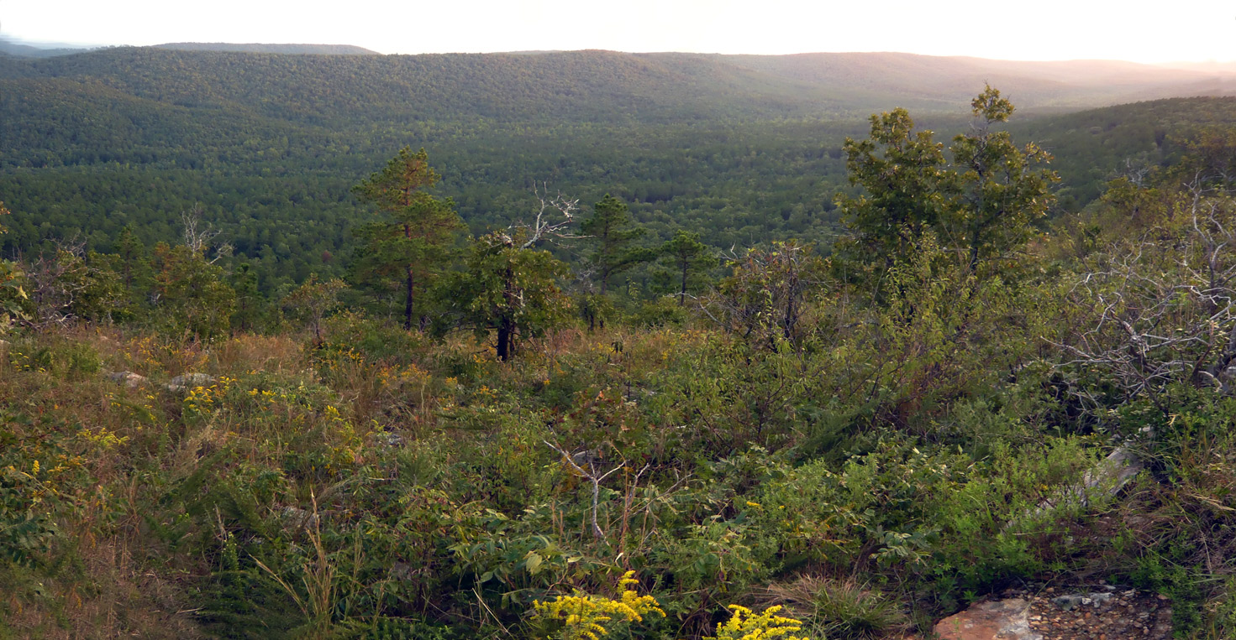
Notes:
Indeed, ridges of equal elevation are common in the Ouachitas - just like in peneplaned and rejuvenated portions of the Appalachians.

Slide 23
Appalachians
Ouachitas
300 miles
Notes:
But the gap that separates the Ouachitas from the Appalachians across the Mississippi Embayment is orders of magnitude wider than the Appalachian water gaps, so something much grander must have happened here.

Slide 24
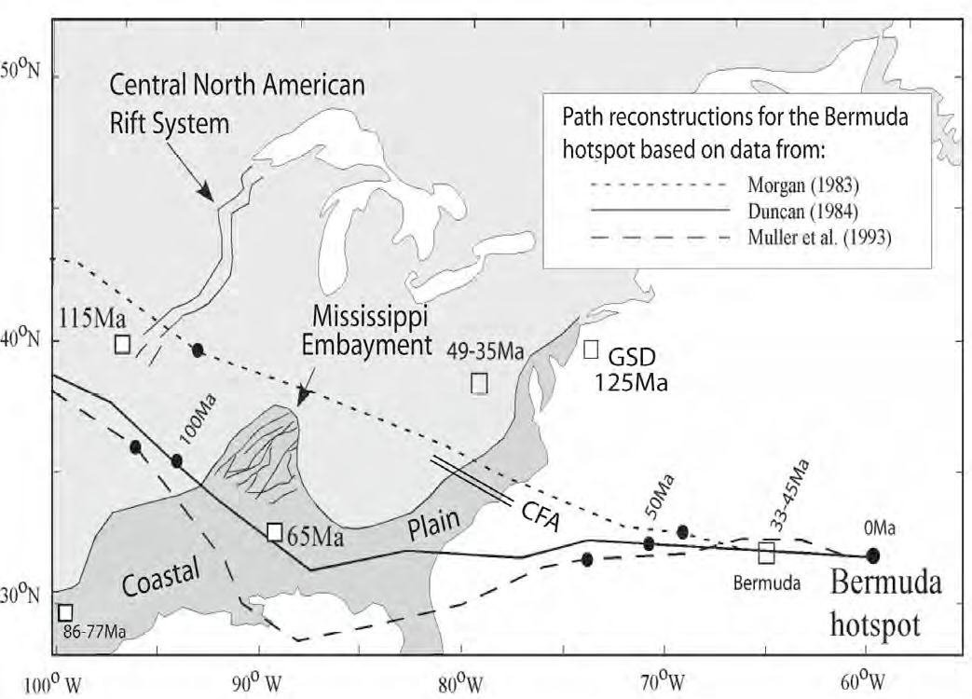
From: Peter R Vogt and Woo-Yeol Jung; GSA Special Paper 430; “Origin of the Bermuda volcanoes and Bermuda Rise: History, Observations, Models, and Puzzles” 2007
Notes:
One relatively new idea, albeit debated, is that the North American continent moved across a stationary hotspot in the mantle. The alleged hotspot currently lies just east of Bermuda, …

Slide 25
Bermuda Hot Spot
Notes:
… and so is known as the Bermuda Hot Spot

Slide 26
70 my
Bermuda Hot Spot
Notes:
Although the hot spot has not moved, the content has. Thus, 70 million years ago the area currently belonging to the Mississippi Embayment was sitting right on top of the hot spot. According to the hypothesis, during this time the hot spot warmed, expanded and domed the continent above it.

Slide 27
60 my
Erosion
Bermuda Hot Spot
Notes:
But as the continent moved west, the dome eroded while a new part of the continent was placed above the stationary hot spot.

Slide 28
50 my
Cooling and Contraction
Bermuda Hot Spot
Notes:
With the dome completely eroded, cooling and contraction lowered the Mississippi Embayment area relative to the adjacent areas, …

Slide 29
Present
Bermuda Hot Spot
Notes:
… and the Mississippi River flowed across the low spot.

Slide 30
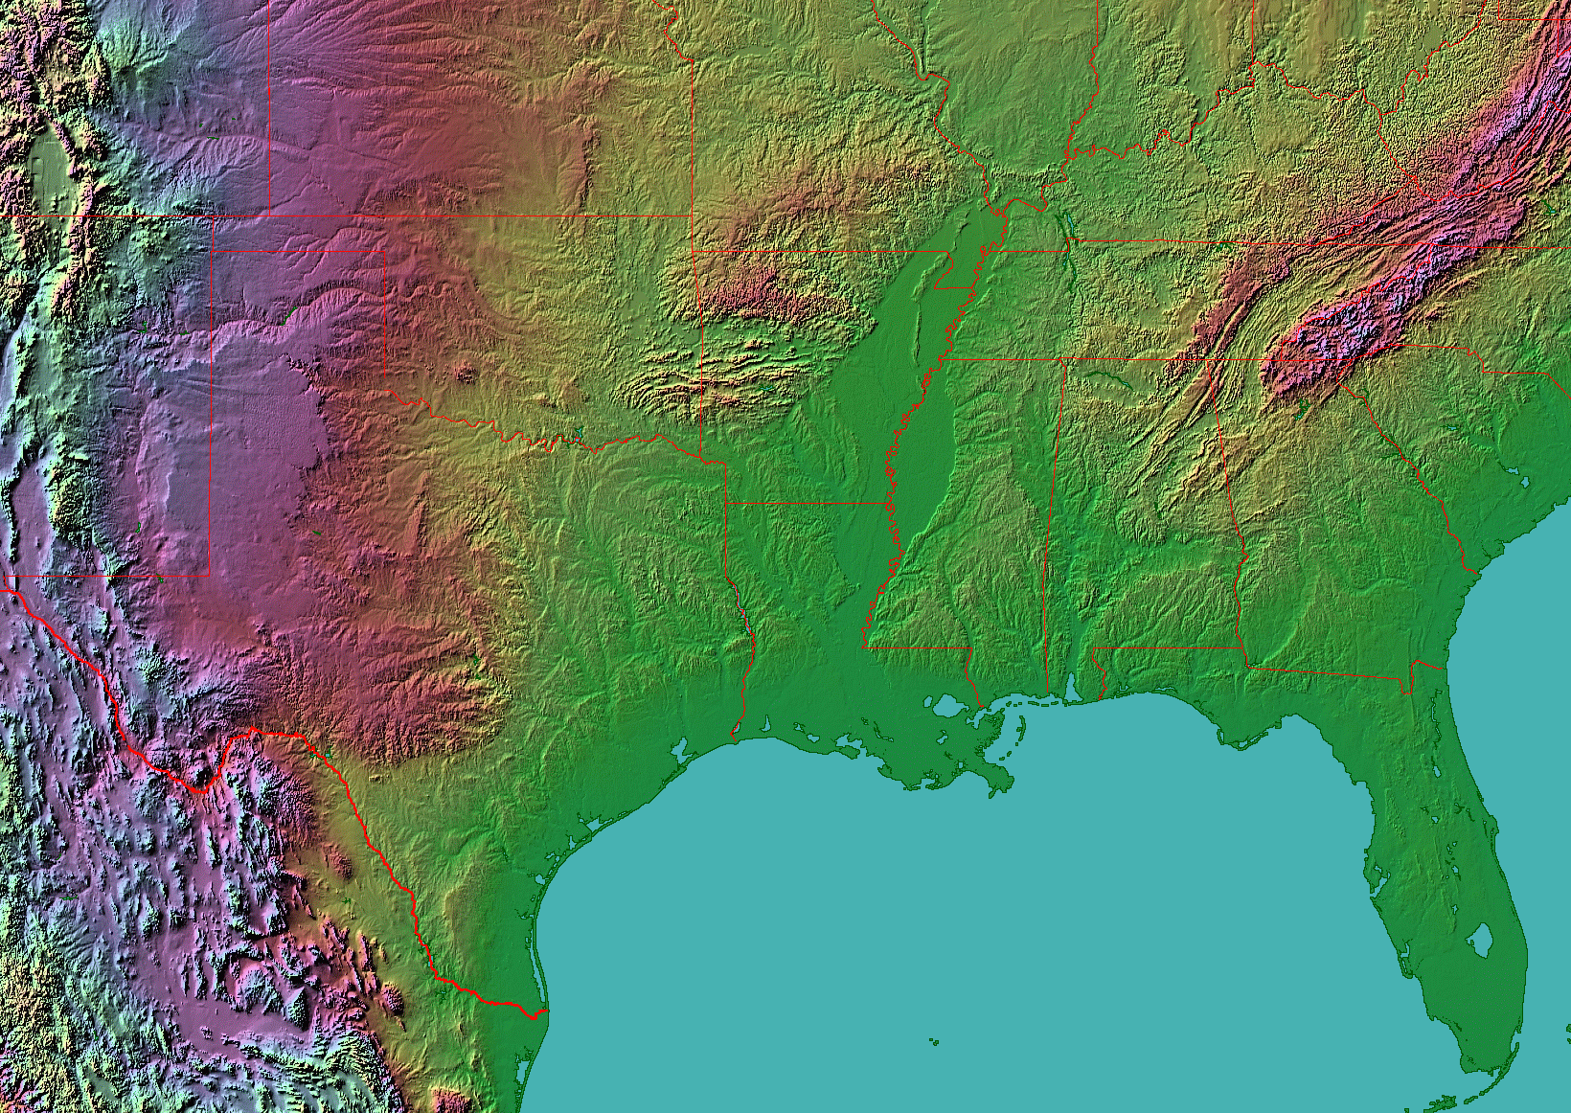
Notes:
There are other explanations for the embayment that rely on reactivating Late Proterozoic rifts in the area,

Slide 31
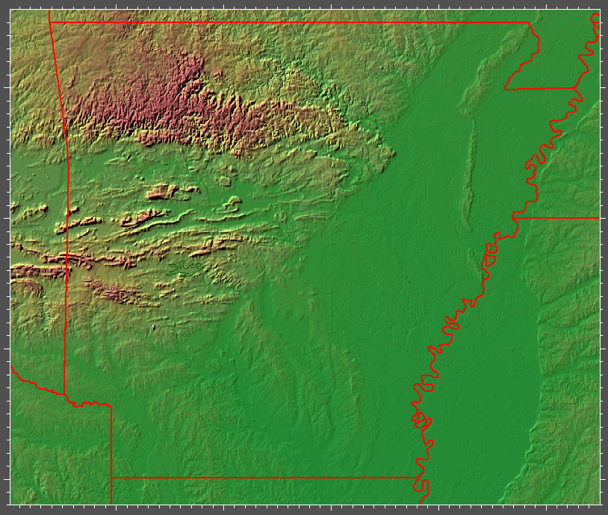
Notes:
… but no matter how you explain the termination of the Ouachita Mountains, their structure is undeniably similar to that of the Appalachian Valley and Ridge Province.

Slide 32
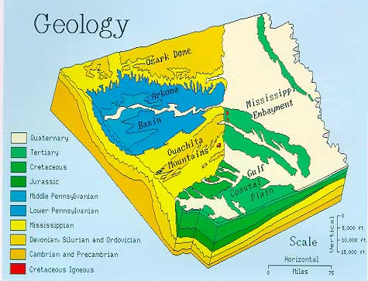
Notes:
On the state-wide scale you can see that the general structure of the Ouachitas is a broad anticline that has uplifted mostly Mississippian and Devonian-aged rocks in its core. Note the Cretaceous igneous rocks in red, possibly related to the passage of the Bermuda Hotspot.

Slide 33
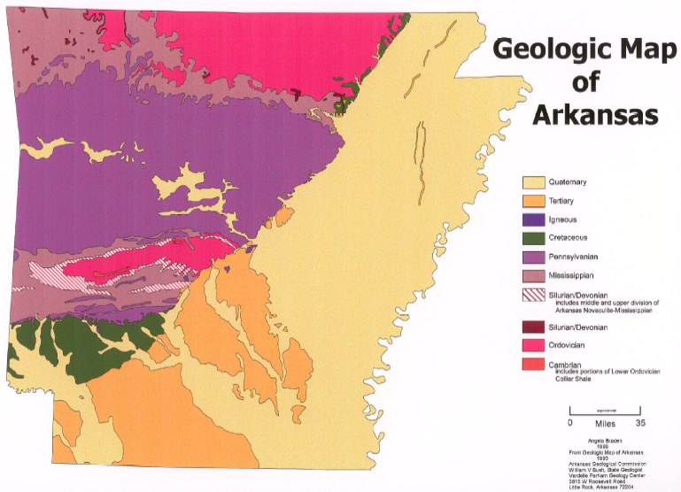
Notes:
If we zoom in from the state wide scale ….

Slide 34
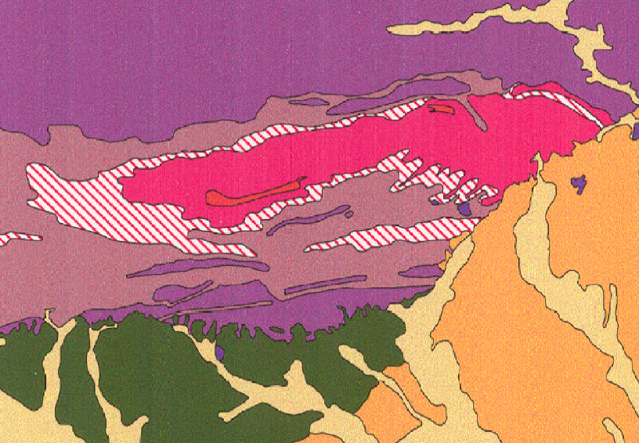
smaller folds
main anticline
Notes:
… down to the scale of the Ouachitas, we can see that there are numerous smaller folds in the aptly named “Zigzag” range superimposed on the main anticline. From their elongated “V” or “U” shapes you should recognize them as plunging folds – just like the type seen in the Appalachians. The direction of plunge is to the southwest.

Slide 35
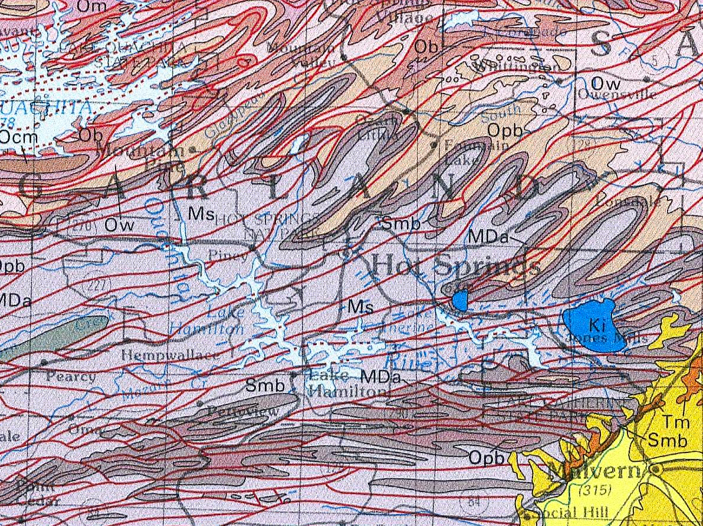
Hot Springs N.P.
Notes:
Following the general trend of the folds in the Zigzag Range are dozens of thrust faults (the red lines here) which complete the association typical of fold and thrust belts like the Valley and Ridge Province. It is the unique combination of this structure and the peculiar rock types found here that have created a system in which groundwater can circulate to great depths, become heated, and then return to the surface.

Slide 36
Arkansas Novaculite
Hot Springs N.P.
Notes:
Key among the rock types that promote the circulation of groundwater here is the Arkansas Novaculite - shown in the striped pattern.

Slide 37
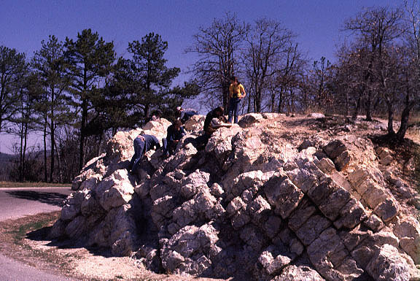
Arkansas Novaculite – Nearly pure silica metachert
Notes:
It is by far the most resistant rock in the region and forms most of the ridges throughout the Ouachitas including those around the Hot Springs area. The Devonian to Mississippian-age formation consists of nearly pure silica …

Slide 38
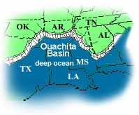
Arkansas Novaculite – Nearly pure silica metachert
Early Paleozoic
Mesozoic
Cenozoic
Notes:
… and represents a deep-sea deposit of siliceous ooze. The ooze hardened into chert, …

Slide 39
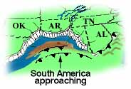
Arkansas Novaculite – Nearly pure silica metachert
Late Paleozoic Ouachita Orogeny
Mesozoic
Cenozoic
Notes:
…and then during the Late Paleozoic Ouachita orogeny as South America collided with North America, mild metamorphism …

Slide 40
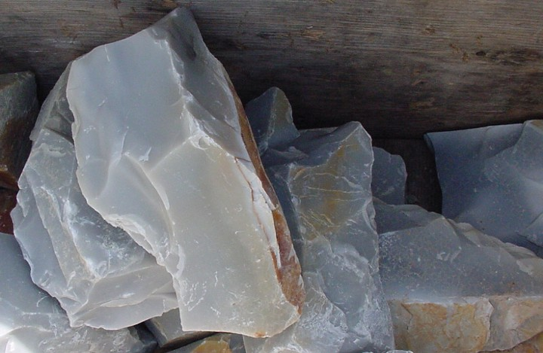
Arkansas Novaculite
Notes:
… slightly recrystallized the chert into Novaculite. This rock is hard, brittle, and extremely resistant to chemical weathering.

Slide 41
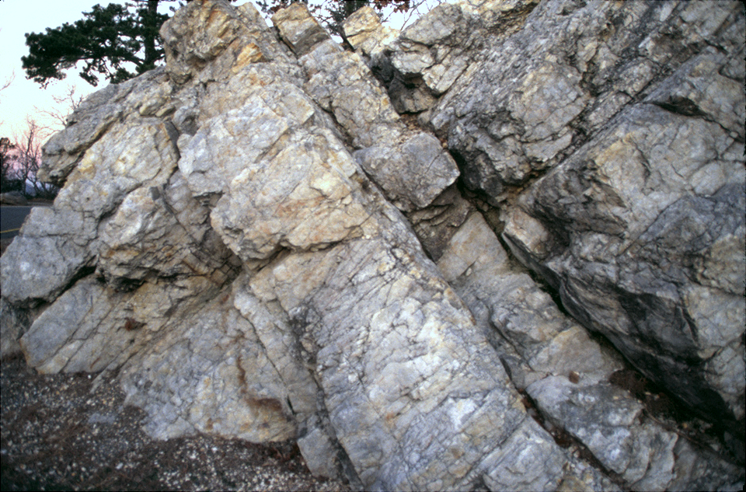
Fractured Arkansas Novaculite
Notes:
Fracture this stuff and you can’t ask for a better medium to transmit groundwater.

Slide 42
Fractured Arkansas Novaculite
Arkansas Novaculite
Notes:
Stratigraphically underlying the Devonian/Mississippian Arkansas Novaculite …

Slide 43
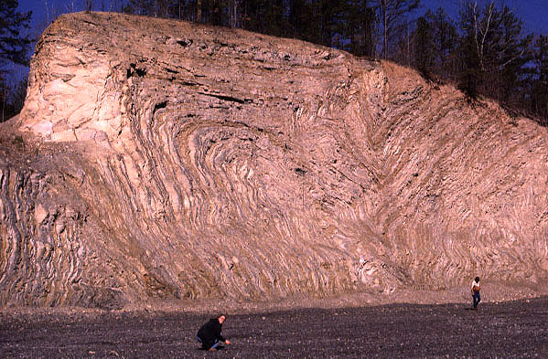
Ordovician Big Fork (interbedded chert and shale)
Arkansas Novaculite
Bigfork Chert
Notes:
.. is the Ordovician Big Fork Chert. In fold and thrust belts the term “stratigraphically” is handy to describe pre-deformation sedimentary relationships, because overturned folds and thrust faults place older units structurally above younger ones. This road cut illustrates the strong deformation and irregular folding characteristic of the Ouachita Orogeny.

Slide 44
Ordovician Big Fork (interbedded chert and shale)
Arkansas Novaculite
Bigfork Chert
Early Paleozoic
Notes:
Like the Arkansas Novaculite, these sediments deposited in the deep water basin that separated North America from South America…

Slide 45
Ordovician Big Fork (interbedded chert and shale)
Late Paleozoic Ouachita Orogeny
Arkansas Novaculite
Bigfork Chert
folding
Notes:
… and the folding resulted from the Ouachita Orogeny. Like the Arkansas Novaculite, the chert here is brittle and thus fractured during folding. The interbedded shale here deformed plastically. Groundwater will be able to flow through the fractured chert and Novaculite, but shale will confine the flow of groundwater.

Slide 46
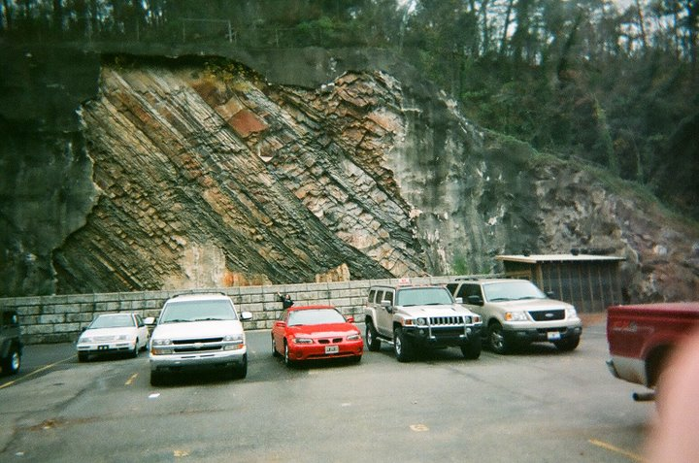
Stanley Shale
Arkansas Novaculite
Bigfork Chert
Notes:
Stratigraphically above the Arkansas Novaculite is the Stanley shale - exposed beautifully here where the gunnite (sprayed-on concrete) has broken off a slope cut into the overturned anticline next to Hot Springs National Park. If this strata is overturned, where would the older Novaculite be? To the left or right of the photo?

Slide 47
SE
NW
Overturned Anticline
Stanley Shale
Bigfork Chert
Arkansas Novaculite
Arkansas Novaculite
Womble Shale
Stanley Shale
NOT TO SCALE
Notes:
Although to the right is the answer I was looking for, to the left is also correct, because the Arkansas Novaculite (in green here) is folded with all the other units such that the same unit may be repeated many times at the surface of a cross section like this. I know visualizing all this in three dimensions is challenging, but the important thing to keep in mind here is that the two brittle units (Arkansas Novaculite and Bigfork Chert) are sandwiched between the Stanley Shale and Womble Shale, …

Slide 48
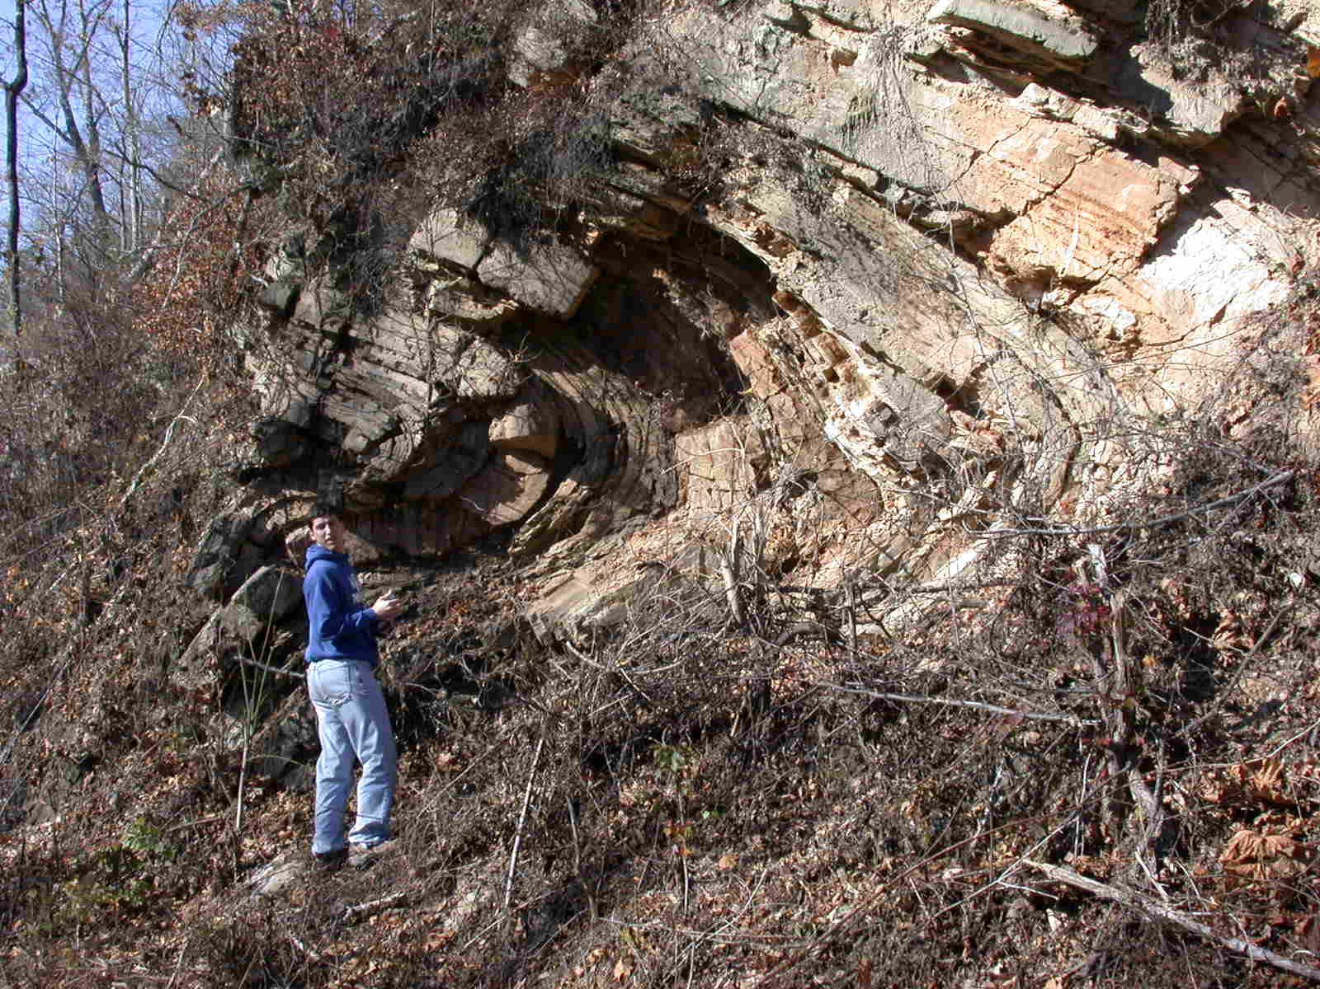
Fractures in brittle chert
Notes:
… and that when bent, groundwater permeable fractures develop in the brittle chert …

Slide 49
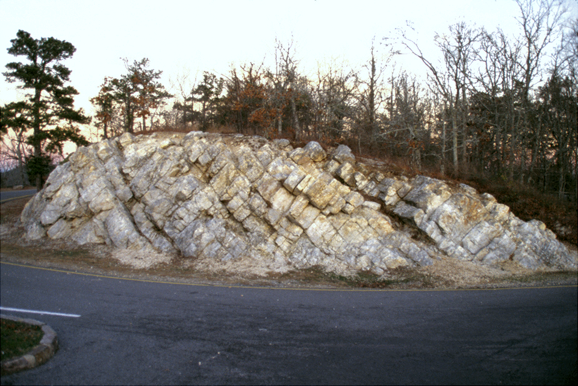
Fractured Arkansas Novaculite
Notes:
… and Novaculite, …

Slide 50
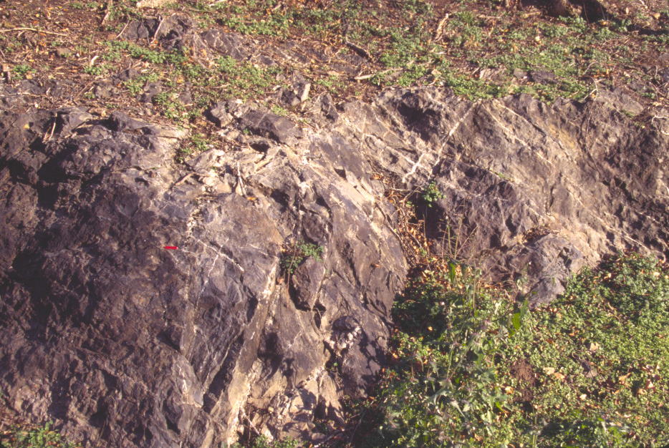
Stanley Shale
Notes:
… but the shale units will deform plastically without developing fractures.

Slide 51
NW
permeable
SE
Notes:
Thus, permeable fractured units …

Slide 52
impermeable
NW
SE
impermeable
Notes:
… are sandwiched between impermeable shale units.

Slide 53
NW
SE
impermeable
permeable
permeable
impermeable
Notes:
This arrangement confines the flow of groundwater from the surface like a hose.

Slide 54
NW
SE
permeable
Thrust Fault
Thrust Fault
Notes:
Faults penetrate the layers, creating a permeable routes for groundwater to flow through the otherwise impermeable Stanley Shale.

Slide 55
NW
SE
Higher elevation
Lower elevation
permeable
Thrust Fault
Thrust Fault
Notes:
Because the Bigfork Chert and Arkansas Novaculite are exposed at a higher elevation than where the thrust faults intersect the surface,

Slide 56
Artesian Springs
permeable
Thrust Fault
Thrust Fault
Notes:
… the weight of the groundwater at higher elevations exerts pressure on the groundwater at lower elevations such that water is forced out of the ground where the faults intersect the surface. Such springs are considered artesian.

Slide 57
Artesian Hot Springs
permeable
Thrust Fault
Thrust Fault
Notes:
The water travels slowly downward to a great depth where it is heated. Acting like a nozzle on a hose, the more narrow (but highly permeable) conduits along the faults, carry the hot water quickly to the surface, before much heat can conduct away from it.

Slide 58
140-150º F
permeable
Thrust Fault
Thrust Fault
Notes:
The water comes out of the springs at a scalding 140-150 degrees Fahrenheit …

Slide 59
Convection
permeable
Thrust Fault
Thrust Fault
Notes:
… because the rate of convective heat flow …

Slide 60
Convection > Conduction
permeable
Thrust Fault
Thrust Fault
Notes:
... is great compared to the rate of conductive heat flow. This principle is acts to some degree in all hot spring systems. Or in everyday life: “Hurry up and bring me my coffee before it cools off!”

Slide 61
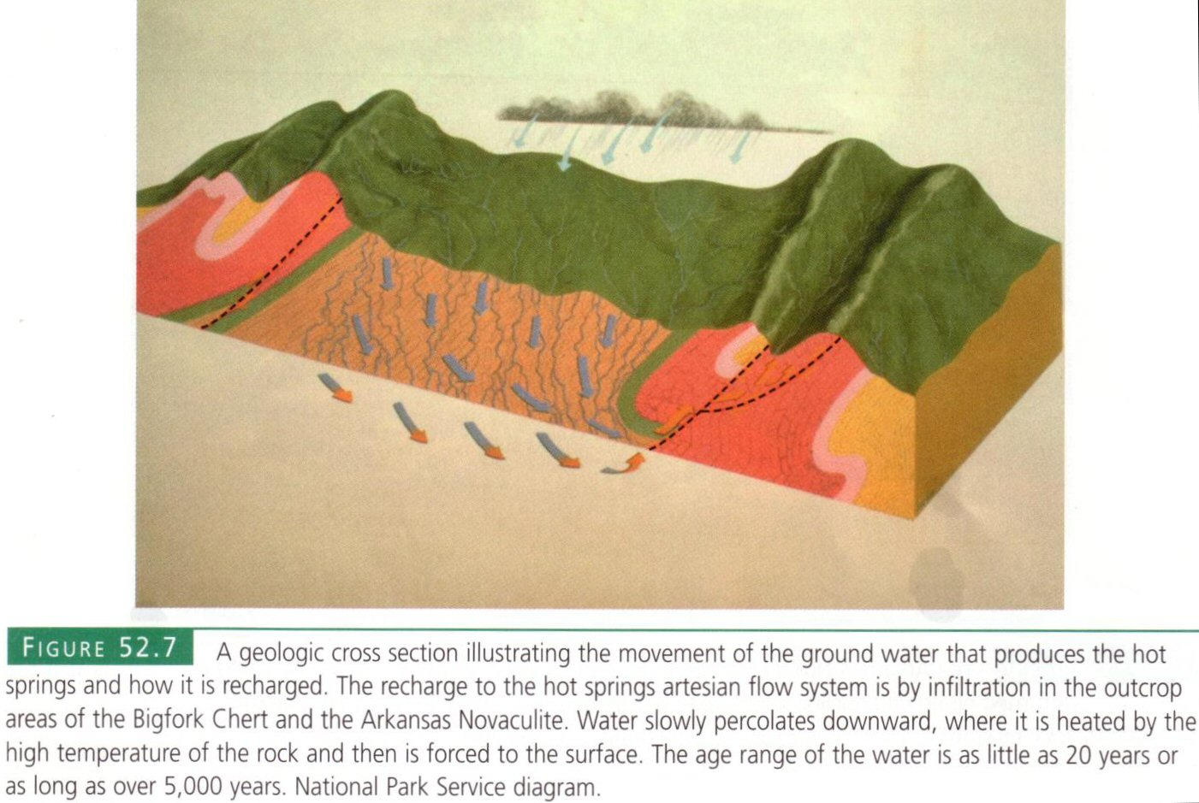
W
E
recharge
Bigfork Chert
Notes:
Most models seem to favor the Bigfork Chert as the unit through which new water is added to the aquifer – a process called recharge.

Slide 62
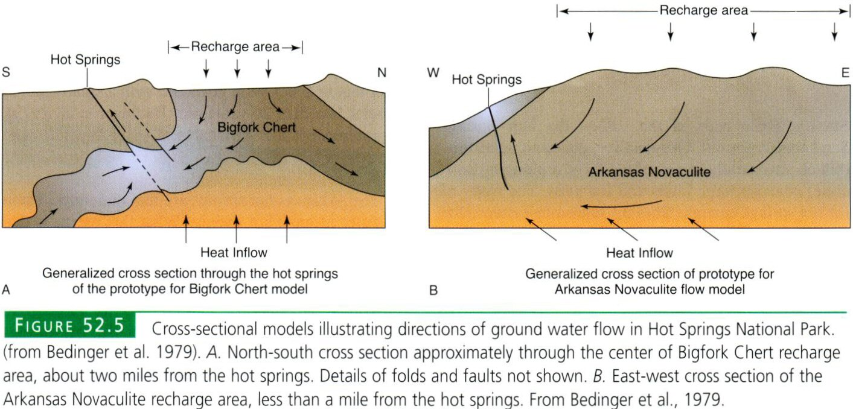
Notes:
Others focus on the Arkansas Novaculite as the recharge unit, but all models rely on thrust faults to get the hot water to the surface quickly.

Slide 63
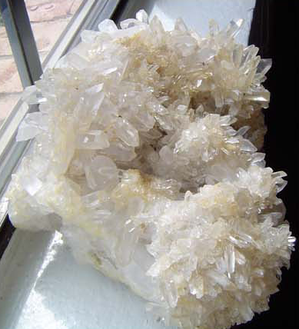
Notes:
Although

Slide 64
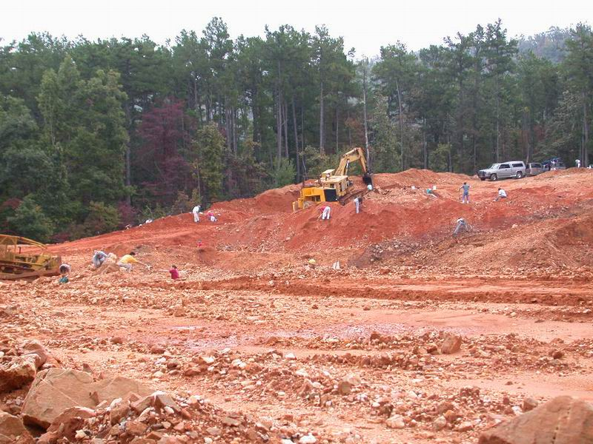

Slide 65
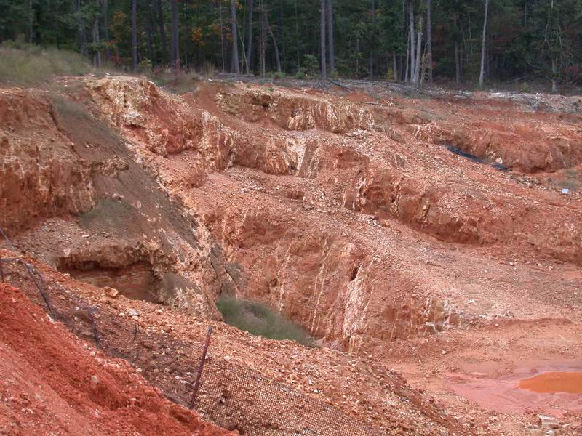

Slide 66
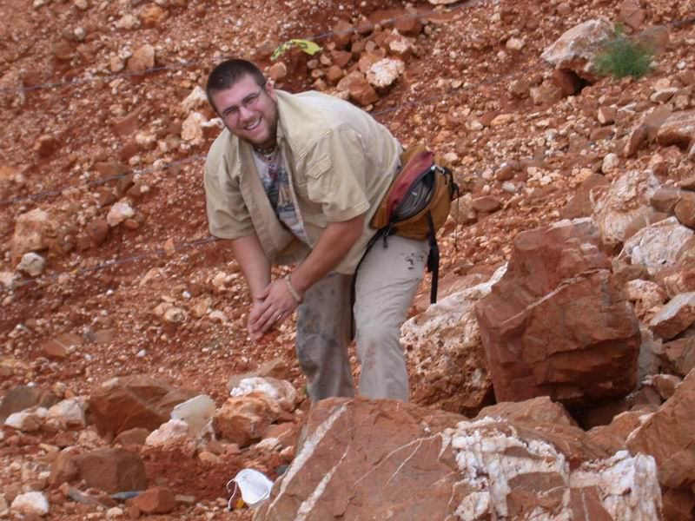

Slide 67
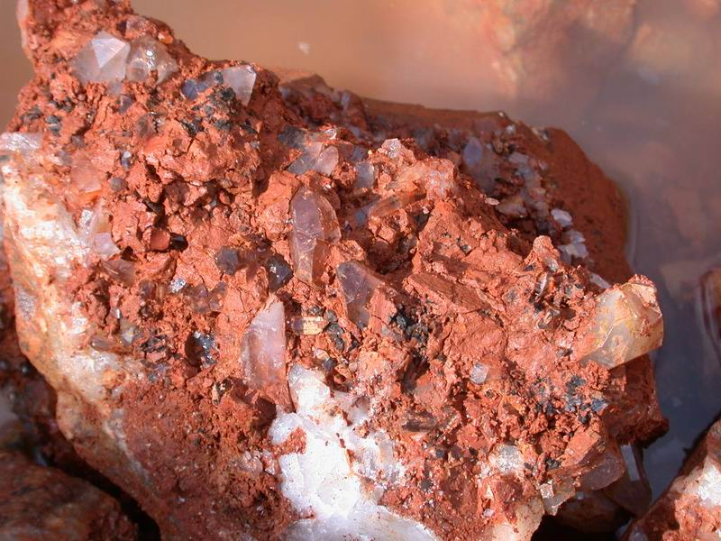

Slide 68
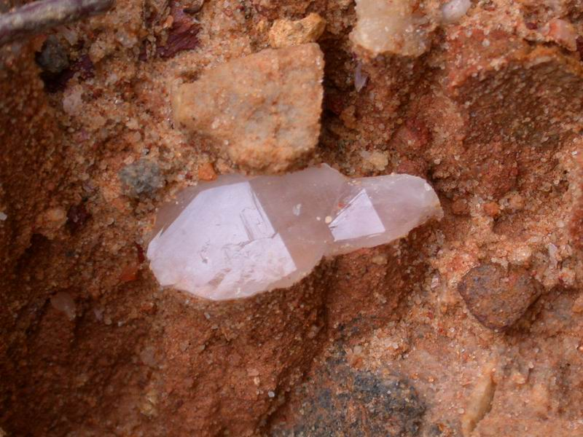

Slide 69
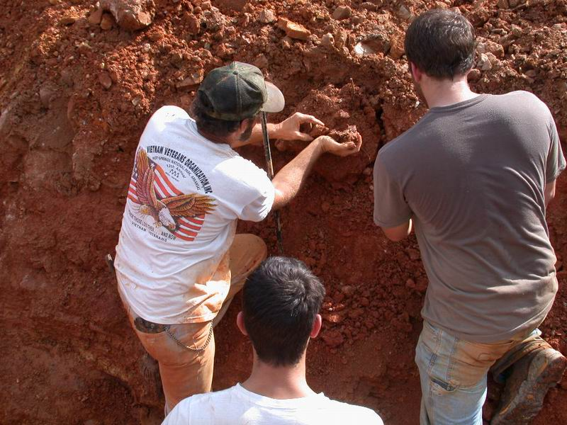

Slide 70
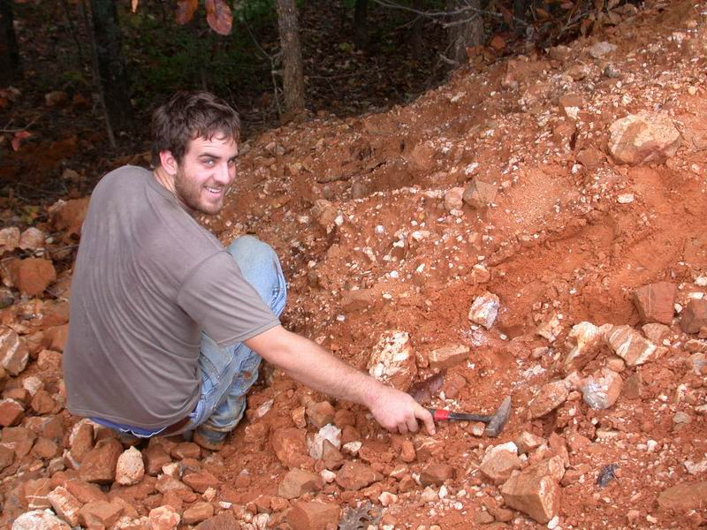

Slide 71
…the source of the silica-rich hot solutions? …the strongest evidence points toward formational brines and fluids forced out during the Ouachita orogeny (mountain-building process) which took place some 286 million years ago.

Slide 72
Mr. Mikey,
Q. Why do quartz crystals have six sides? I found a quartz crystal with four sides, what does this mean? I also found a copperhead snake with 2 heads. What’s up with that? Thanks for answering my questions. When I grow up I want to be a geologist just like you. Your friend, Billy

Slide 73
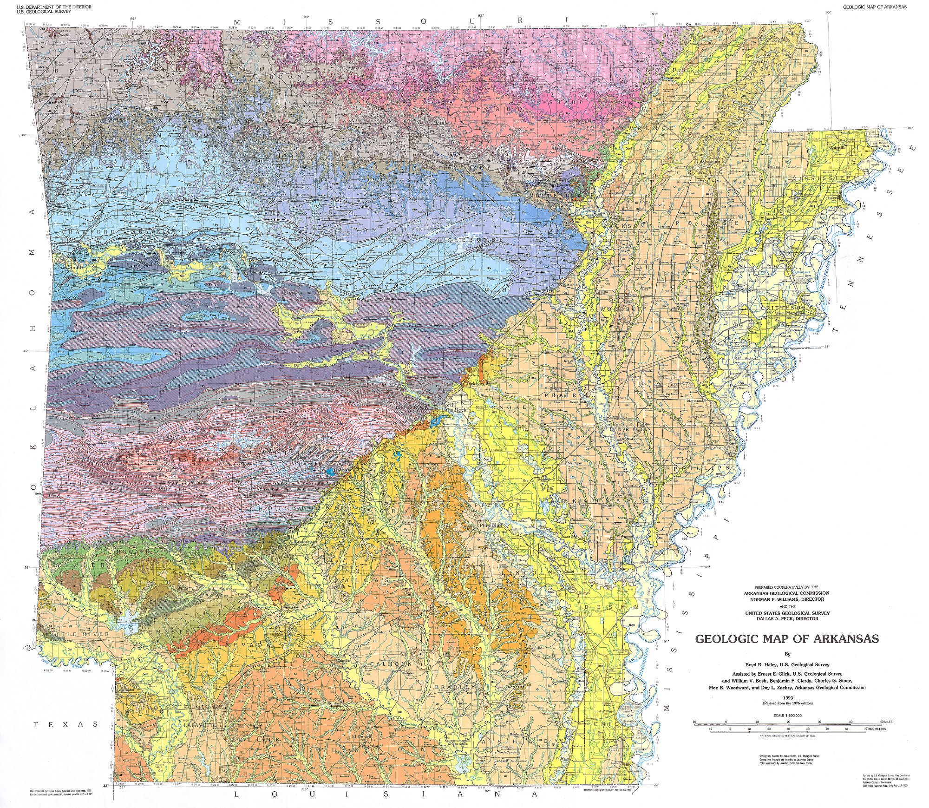

Slide 75
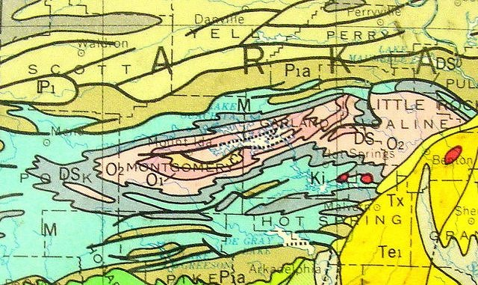

Slide 76
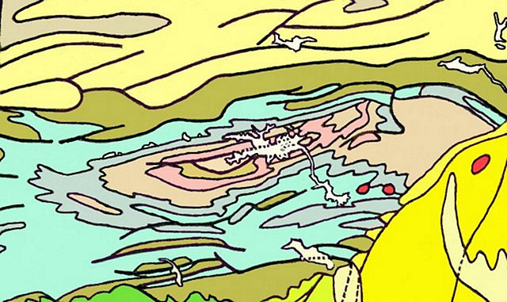

Slide 77
Notes:
Hot Springs 16 DBH Along Bathhouse Row

Slide 79
Notes:
Along with the

Slide 82
Early Paleozoic
Late Paleozoic
Mesozoic
Cenozoic

Slide 83
Notes:
Top of west mountain

